Slide 1

Mobile Learning Application Development
Presented By:
Rakib Hossen
Assistant Professor
Dept. of Cyber Security Engineering (CySE), UFTB

Slide 2


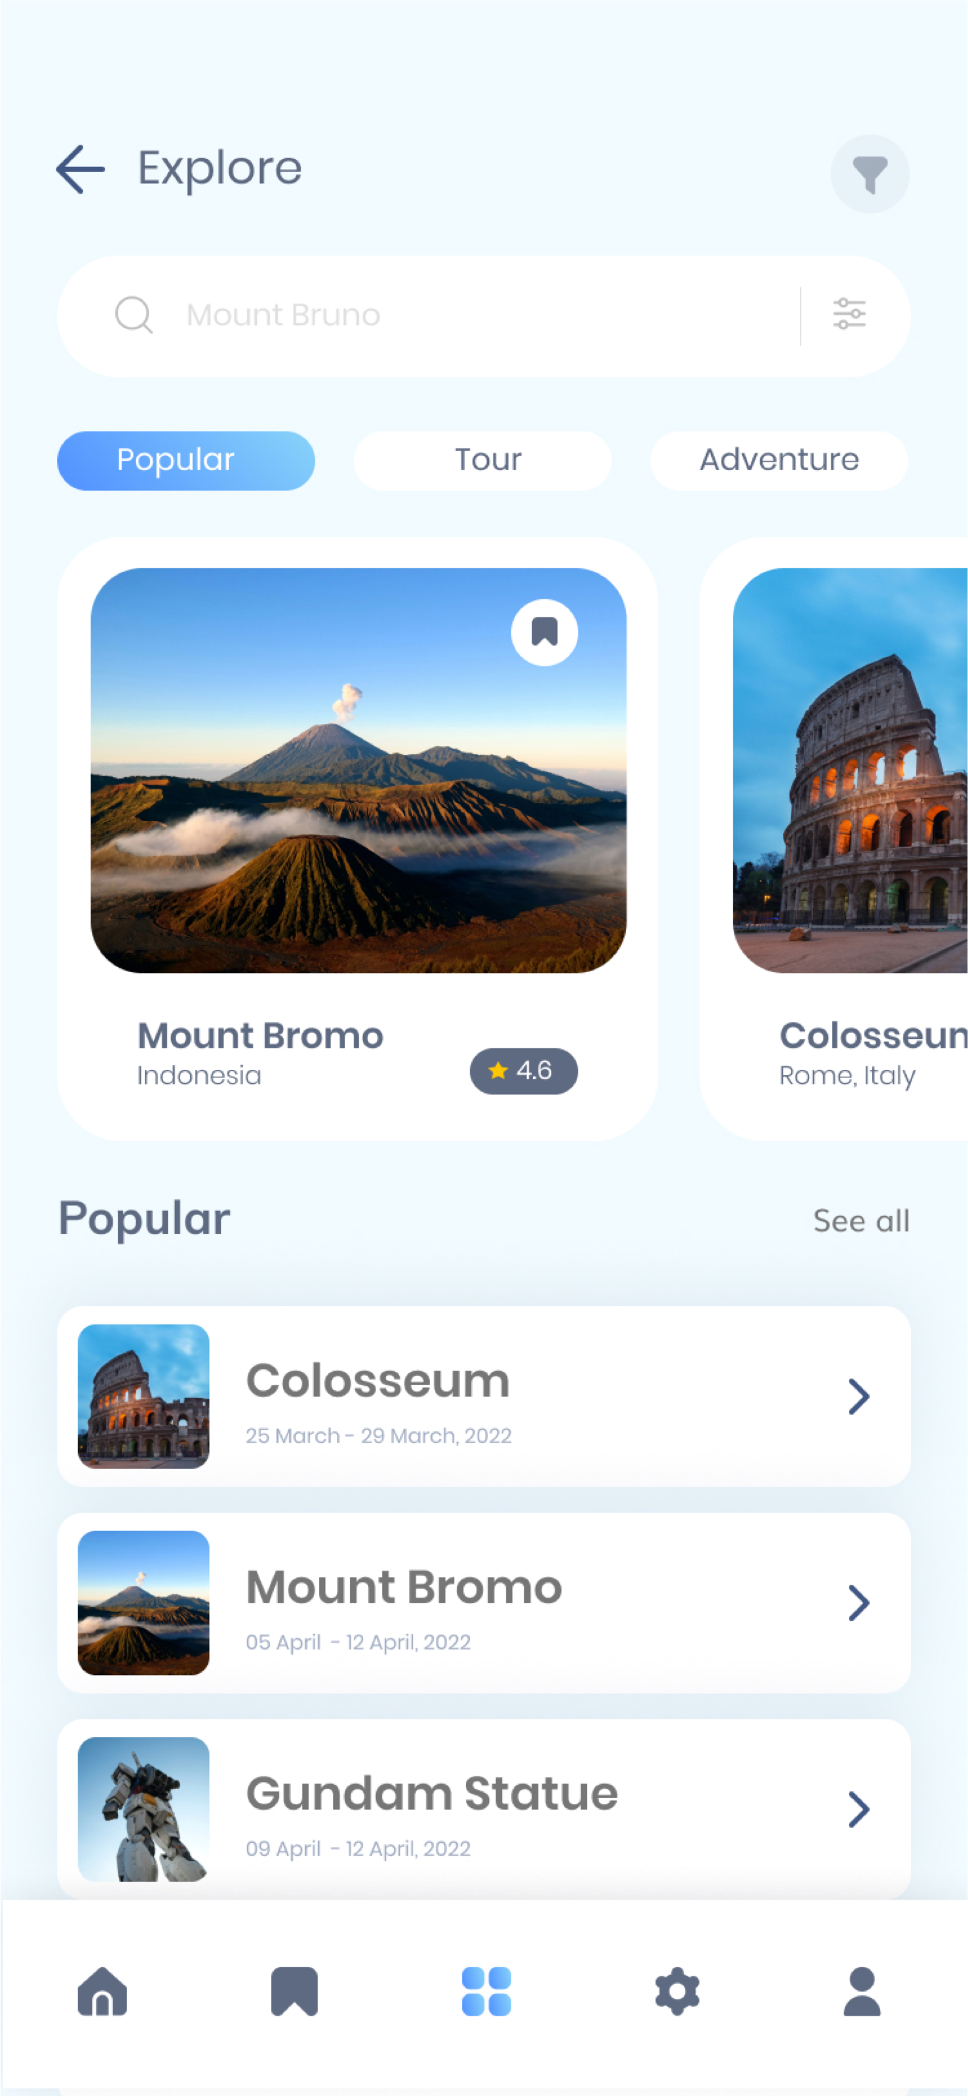
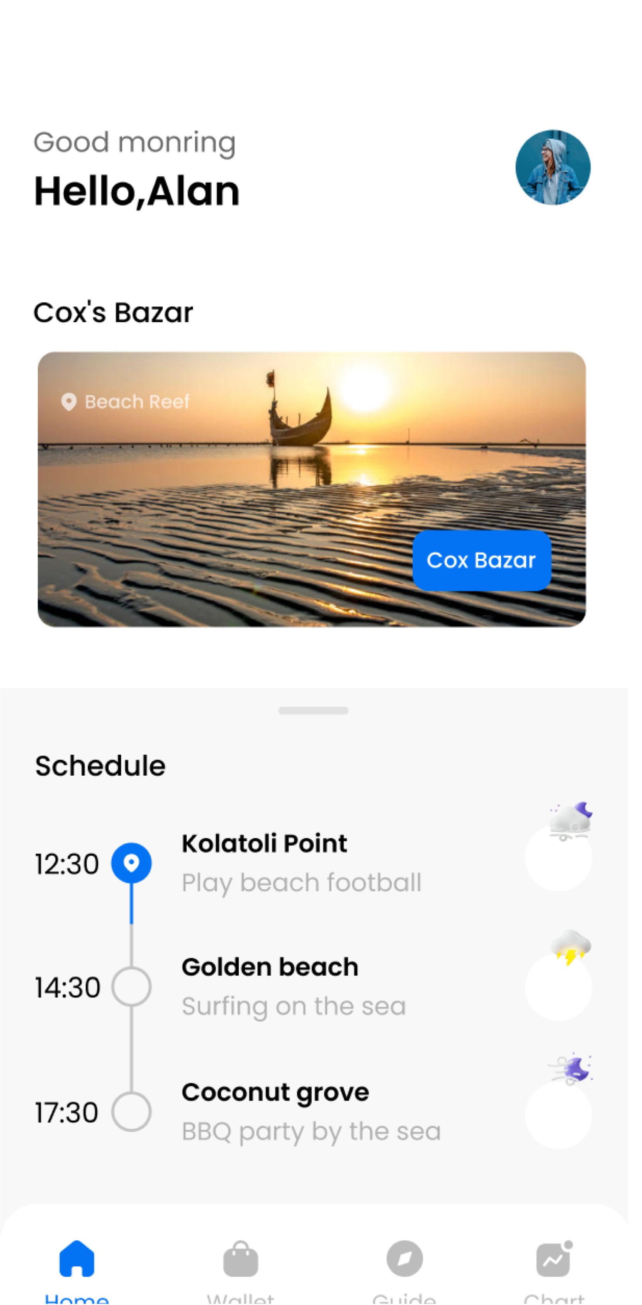
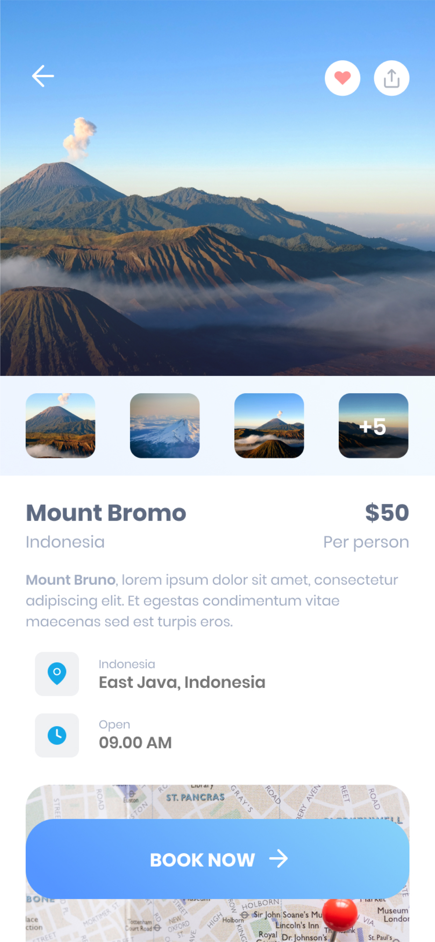
Activity & Widgets

Slide 3
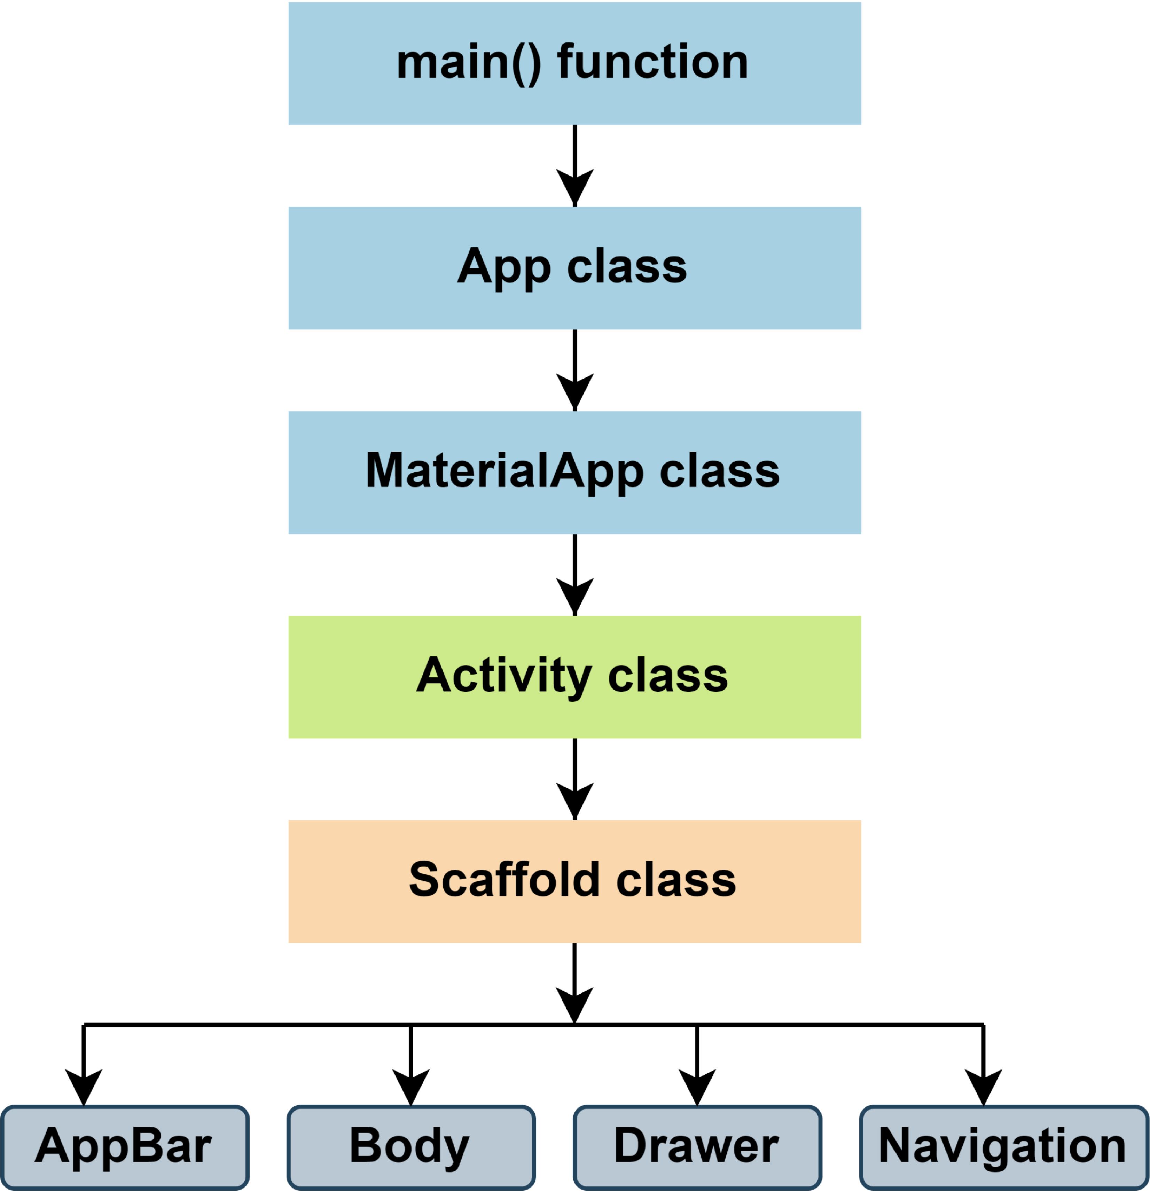
Flutter Main Source Code Flow

Slide 4
Material App Class
Predefined class in a flutter.
Core component of flutter.
Some Essential Properties
color: It controls the primary color used in the application.
darkTheme: It provided theme data for the dark theme for the application.
debugShowCheckedModeBanner: This property takes in a boolean as the object to decide whether to show the debug banner or not.
home: This property takes in widget as the object to show on the default route of the app.
title: The title property takes in a string as the object to decide the one-line description of the app for the device.
Official Documentation: https://api.flutter.dev/flutter/material/MaterialApp-class.html

Slide 5
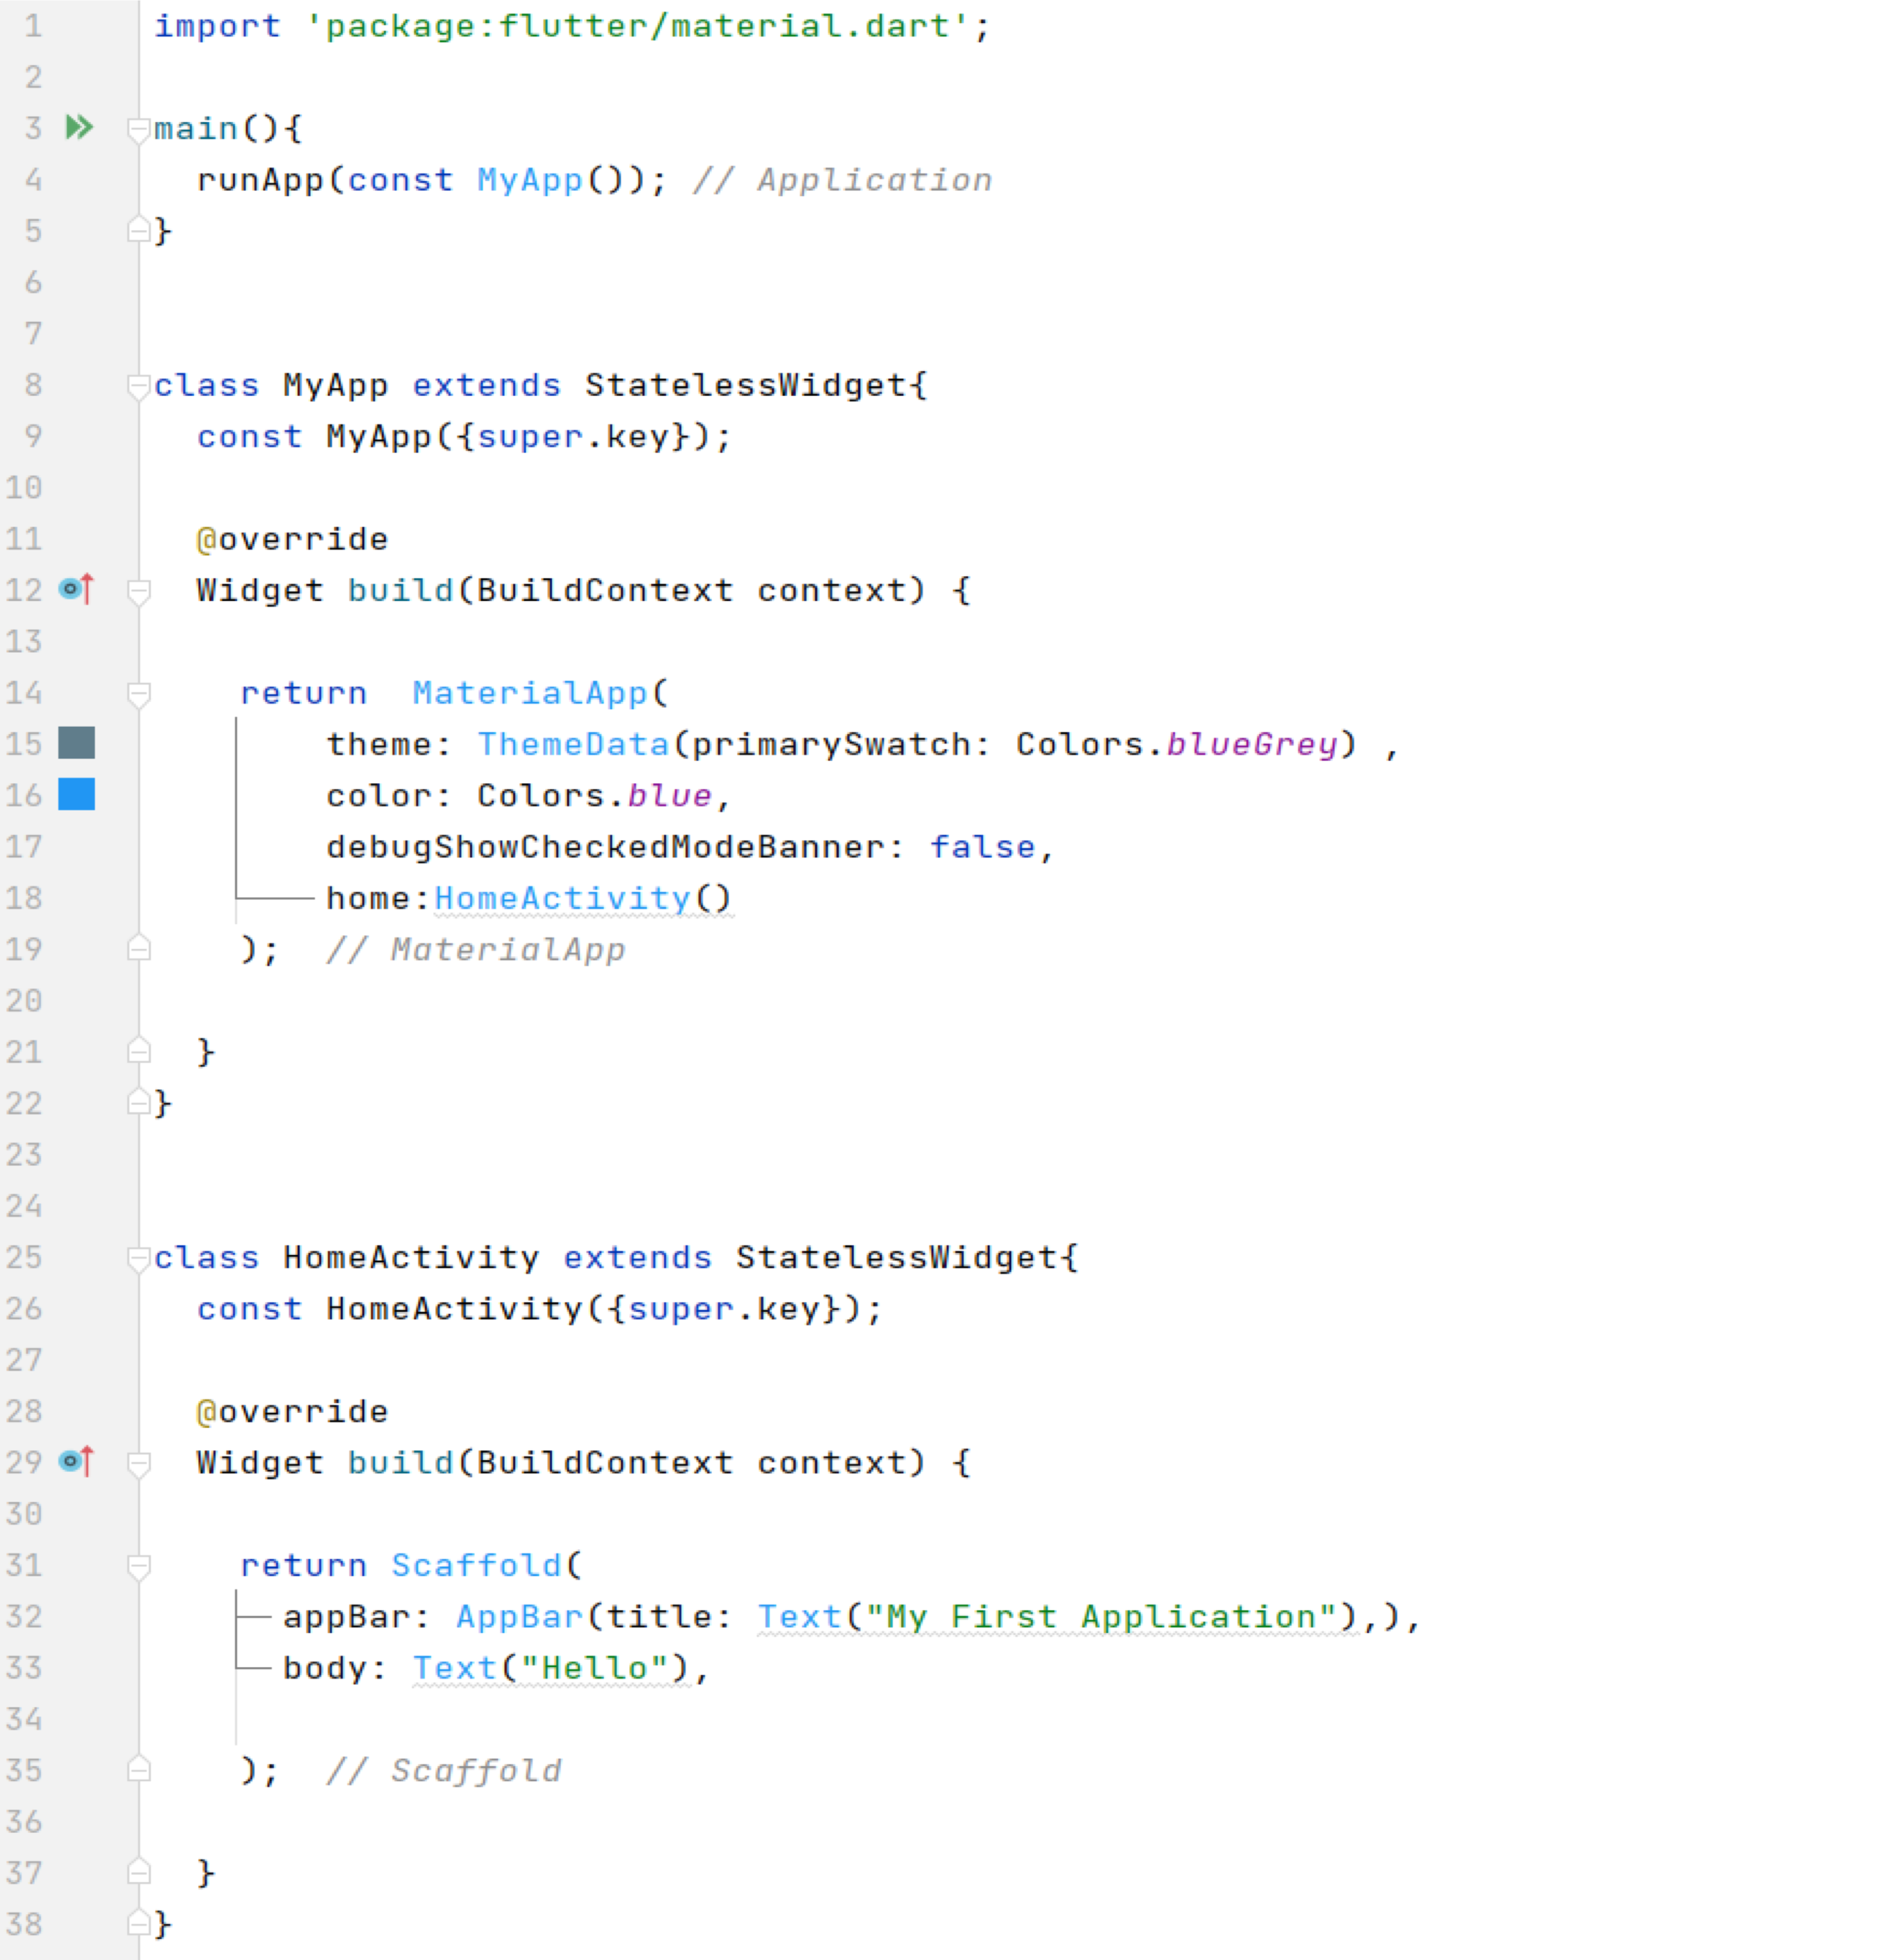
Material App Class

Slide 6
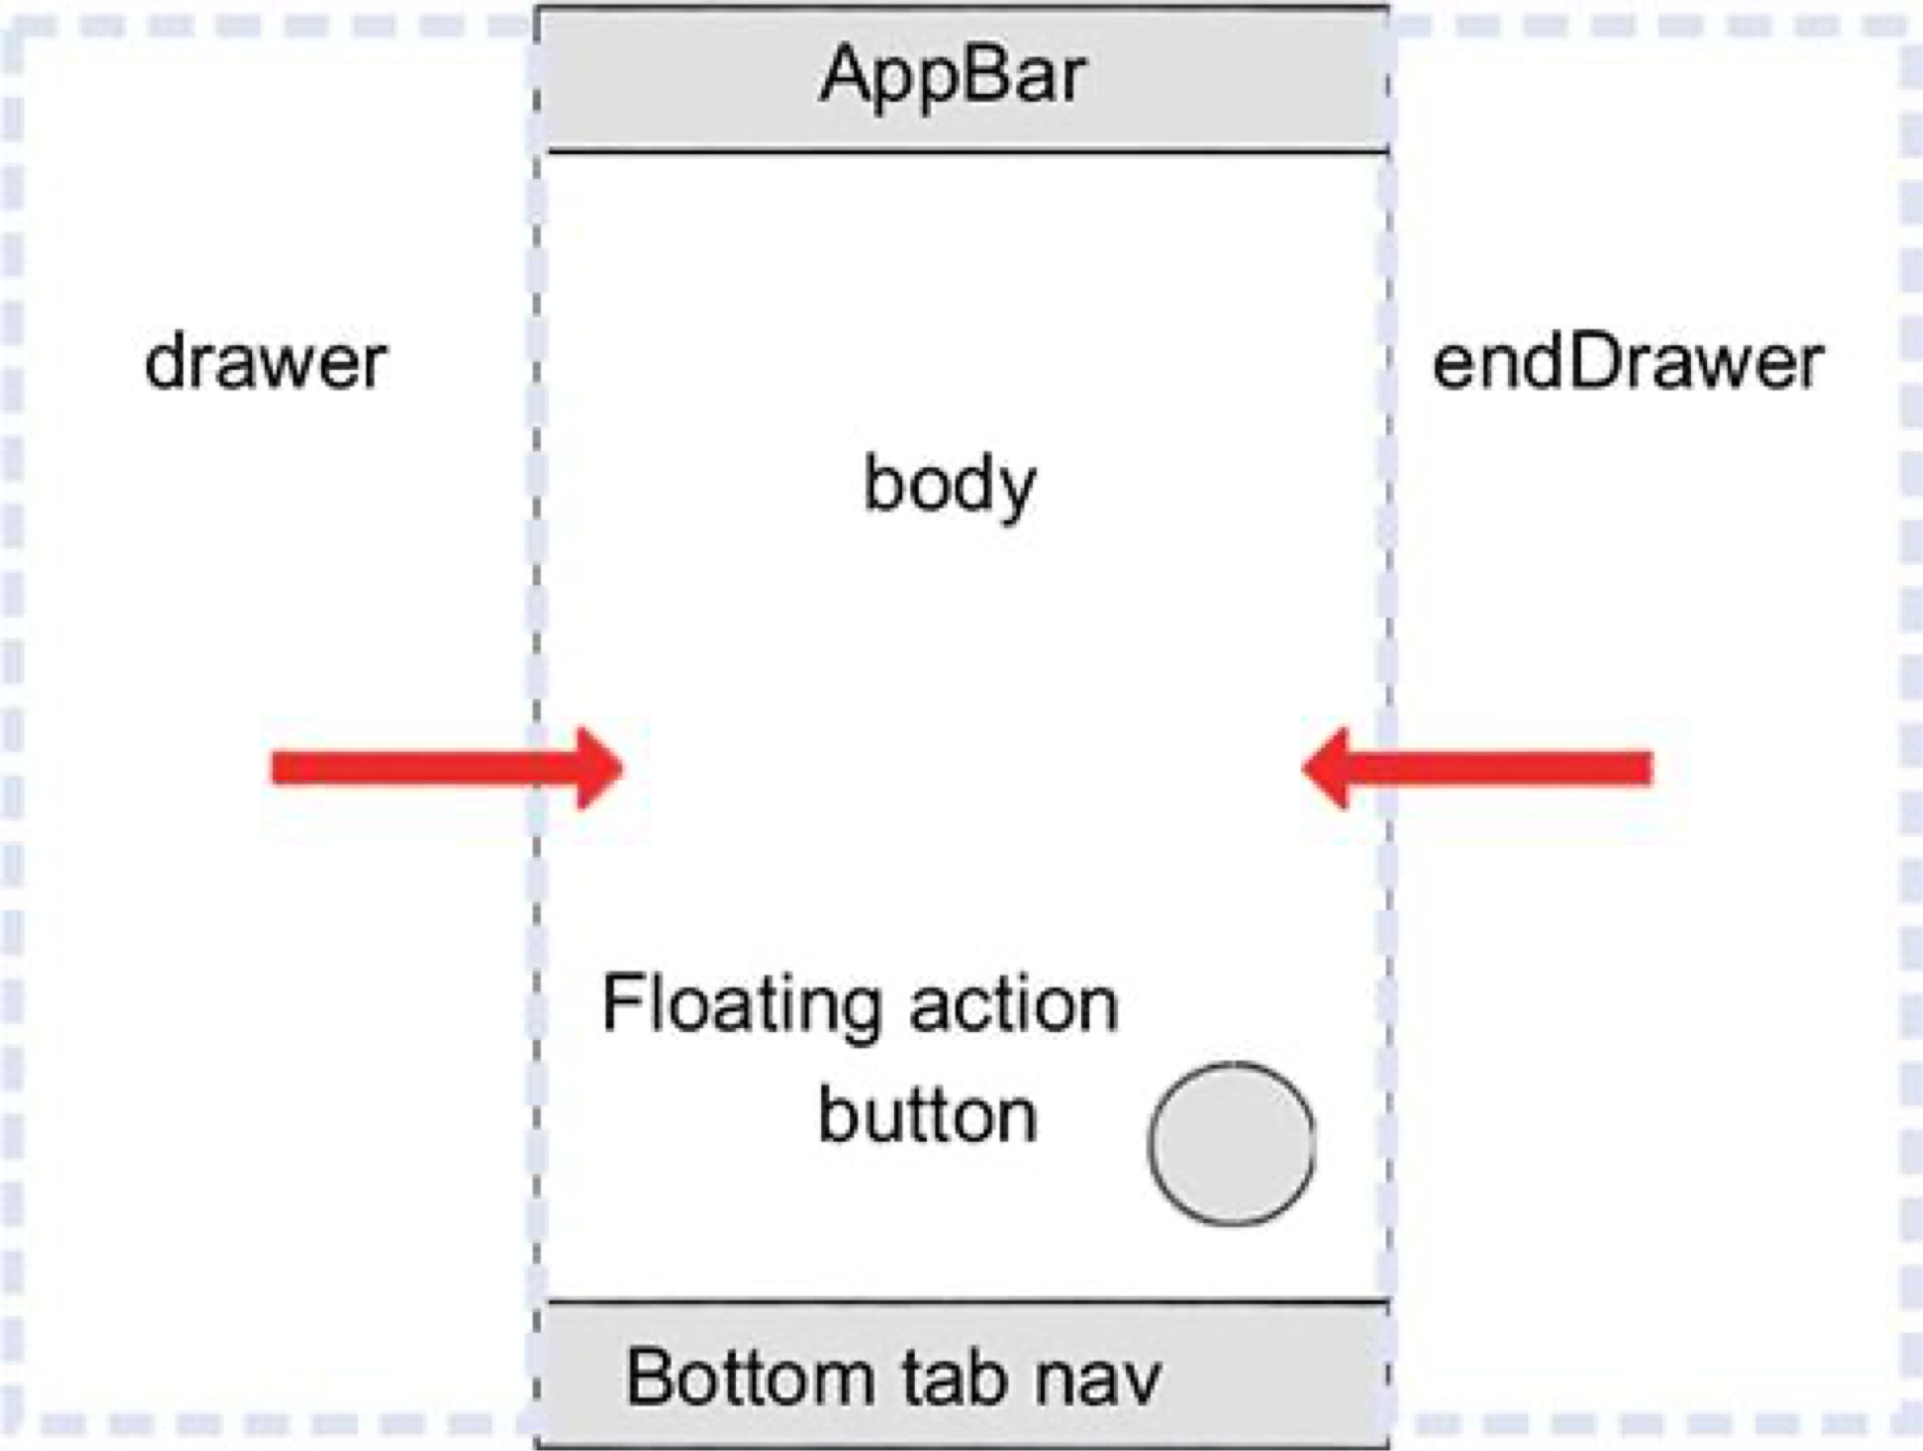
Scaffold Class
Predefined class in a flutter.
Core component of flutter.
Scaffold will expand or occupy the whole device screen.
Official Documentation: https://api.flutter.dev/flutter/material/Scaffold-class.html

Slide 7
Scaffold Class
Some Essential Properties
appBar: An app bar to display at the top of the scaffold.
backgroundColor: The color of the Material widget that underlies the entire Scaffold.
body: The primary content of the scaffold.
bottomNavigationBar: A bottom navigation bar to display at the bottom of the scaffold.
drawer: A panel displayed to the side of the body, often hidden on mobile devices. Swipes in from either left- to-right or right-to-left
endDrawer: A panel displayed to the side of the body, often hidden on mobile devices. Swipes in from right- to-left or left-to-right
floatingActionButton: Animator to move the floatingActionButton to a new floatingActionButtonLocation.

Slide 8
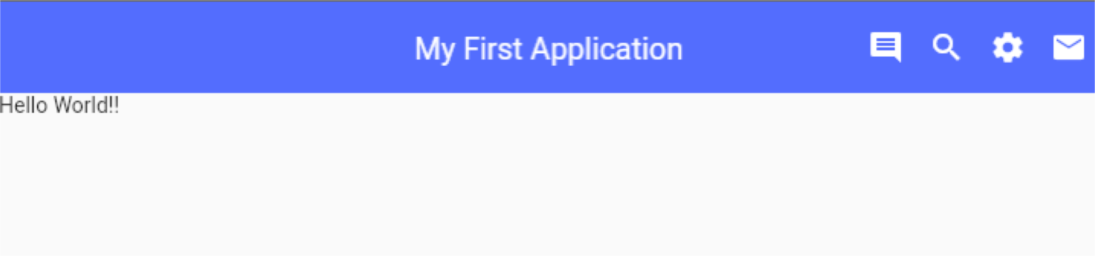
AppBar Widget
AppBar is usually the topmost component of the app .
It contains the toolbar and some other common action buttons.
Some essential properties
actions: This property takes in a list of widgets as a parameter to be displayed after the title if the AppBar is a row.
title: This property usually takes in the main widget as a parameter to be displayed in the AppBar.
backgroundColor: This property is used to add colors to the background of the Appbar.
elevation: This property is used to set the z-coordinate at which to place this app bar relative to its parent.
shape: This property is used to give shape to the Appbar and manage its shadow.
Official documentation: https://api.flutter.dev/flutter/material/AppBar-class.html

